Slide 1
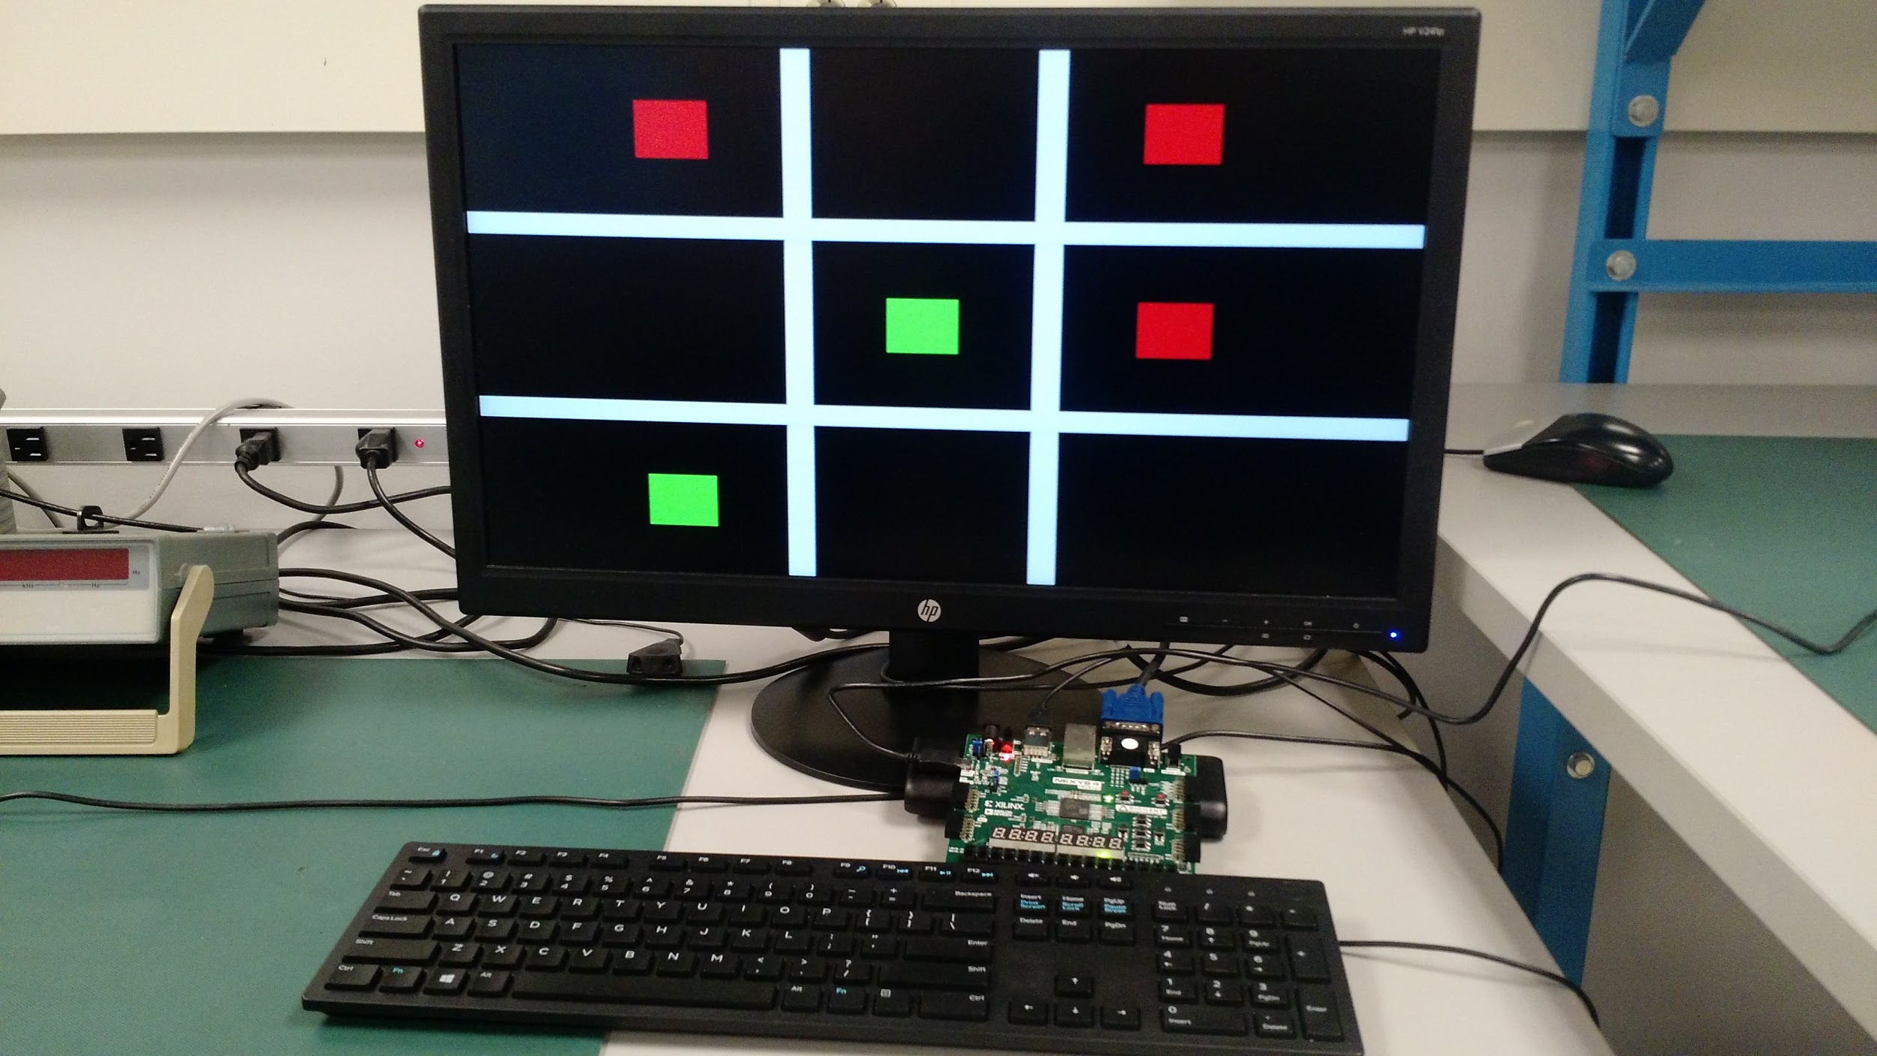
Two-player Tic-Tac-Toe
Kyle Jonas
Karina Cuadrado
Team 2C
CMPEN 371: Final Project

Slide 2
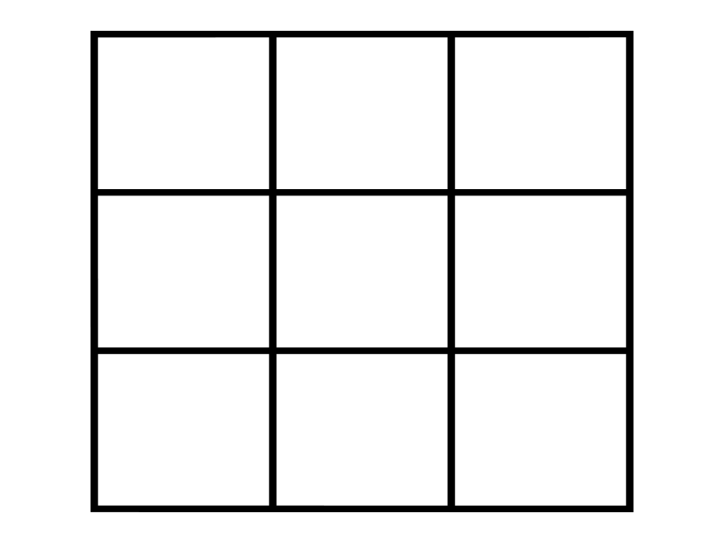
Introduction
Objective
Design and implement a two-player Tic-Tac-Toe game displayed through VGA with keyboard interaction (keypad assign to game board positions)
Design overview
Split top-module into 2 internal sub components: VGAControl and GameControl.
1 2 3
4 5 6
7 8 9
Game board positions:

Slide 3
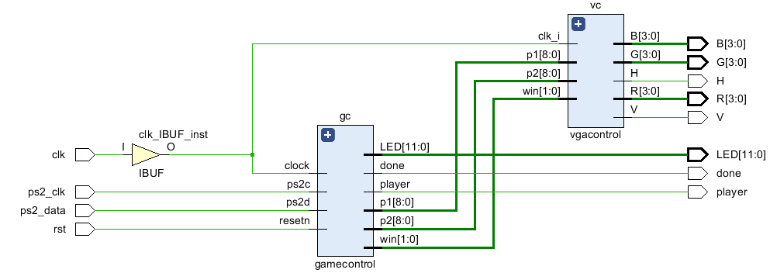
Top-level design

Slide 4
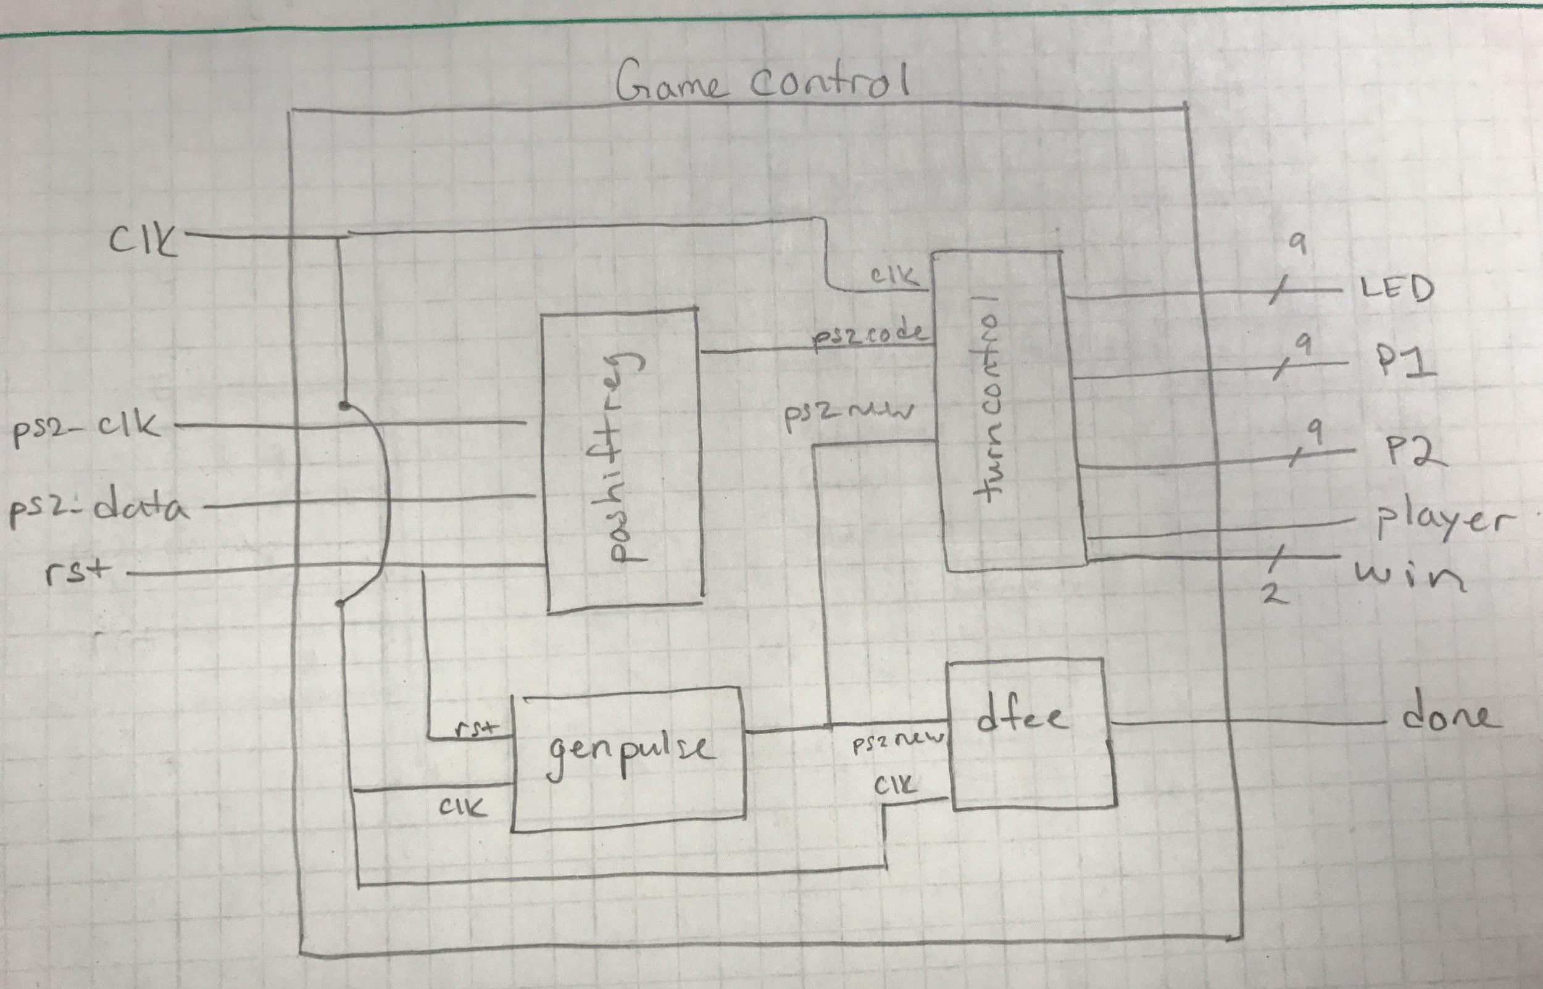
Game control module

Slide 5
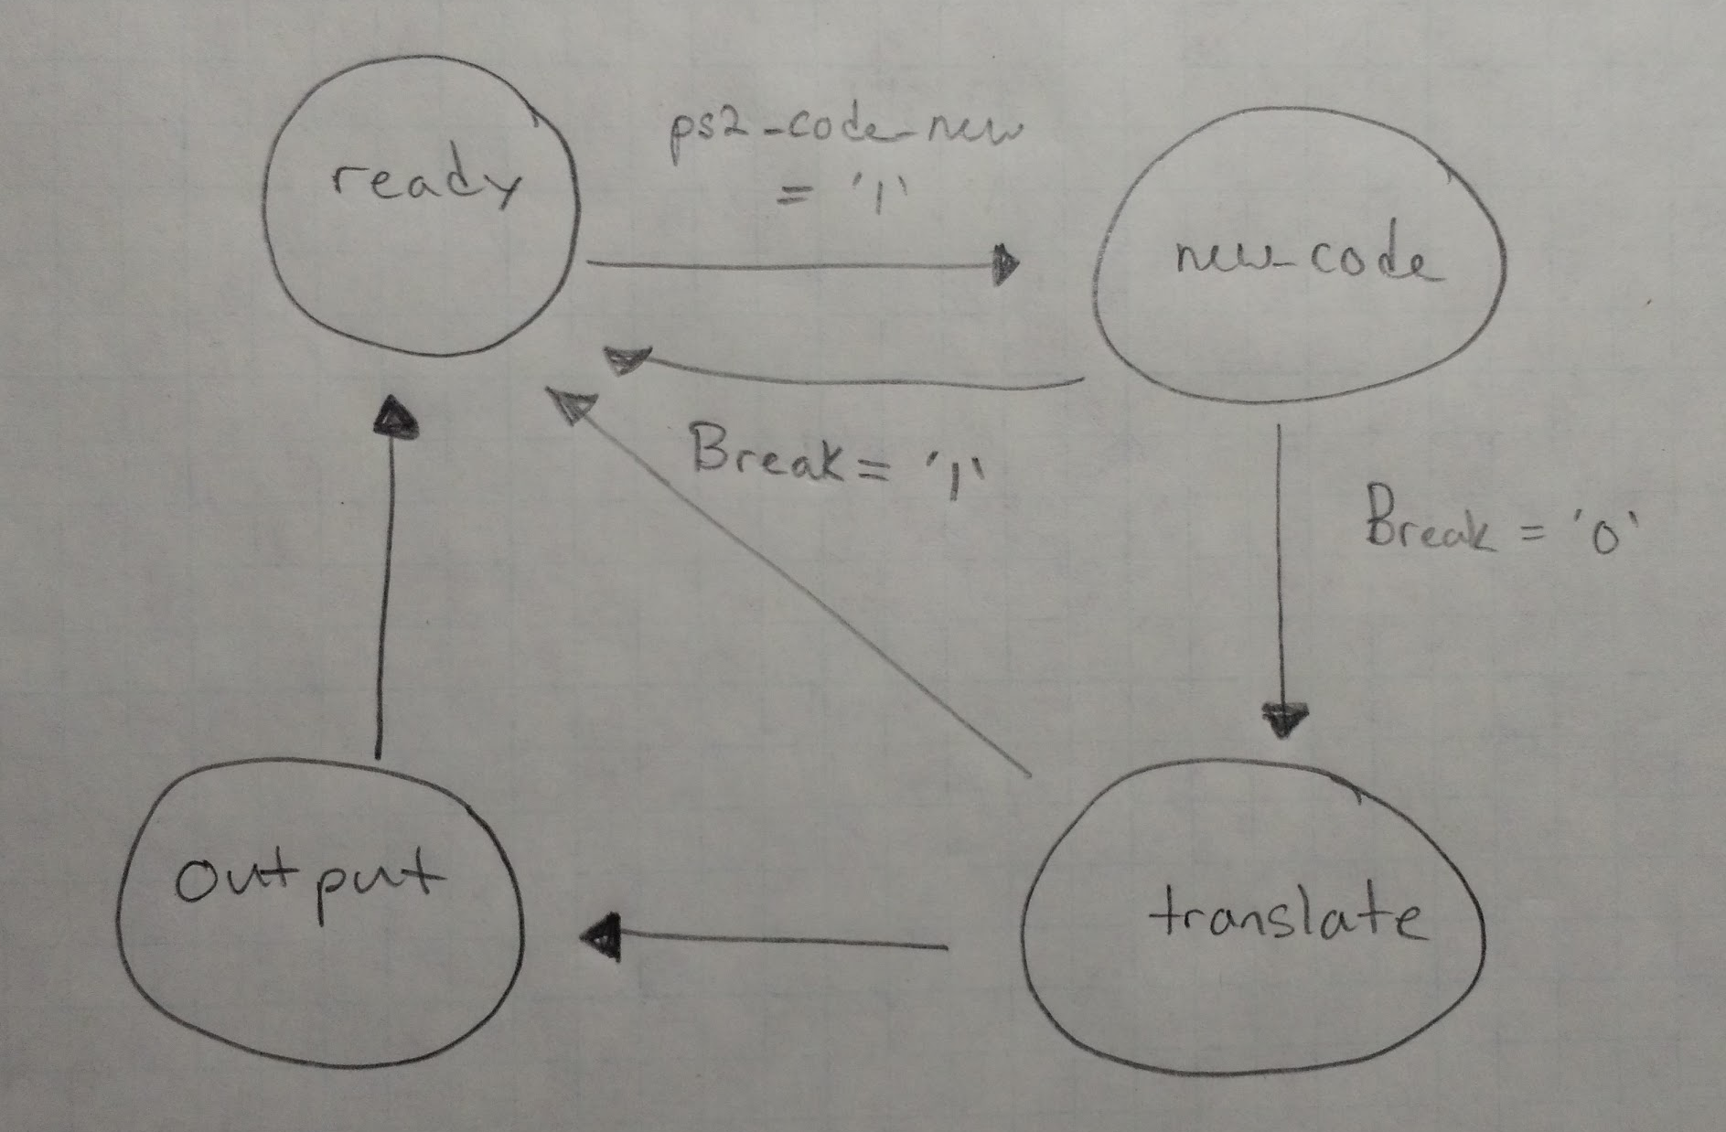
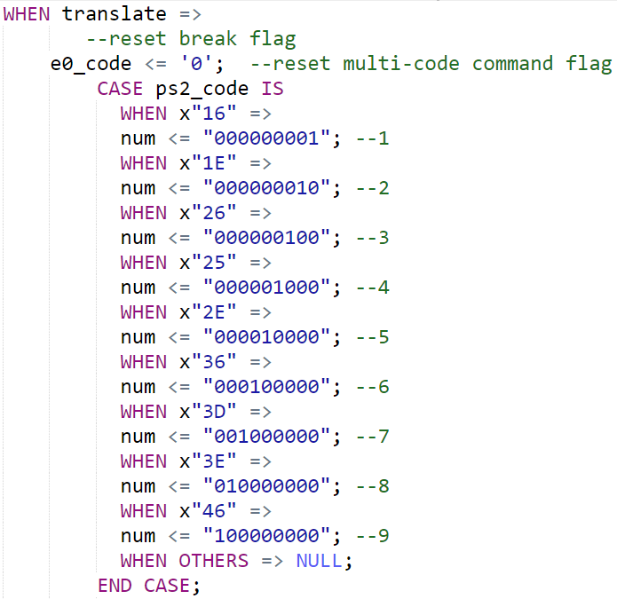
Turn Control State Diagram
Ready: Waits for new keypress
New Code: Checks for break/multi key
Translate: On #1-9 keeps track of board location
Output: Checks if game board is empty and then assigns player to location, alternates turn

Slide 6
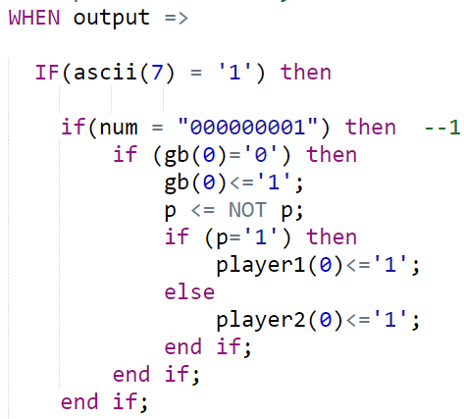
Player Logic
Major signals
Three 9 bit signals for P1, P2 and game board
2 bit win signal
On keypress, checks for #1-9
Compare # to Game Board bit
If empty, sets bit to 1, sets player signal bit to 1, then alternates turn
If full, falls back to state waiting for new keypress
Checks all possible win combinations
Passes P1, P2, and win to VGA controller

Slide 7
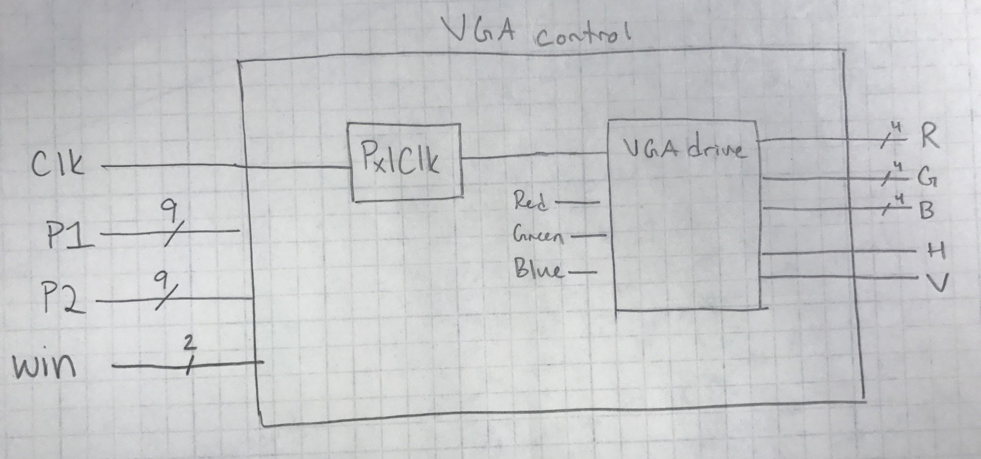
VGA control module

Slide 8
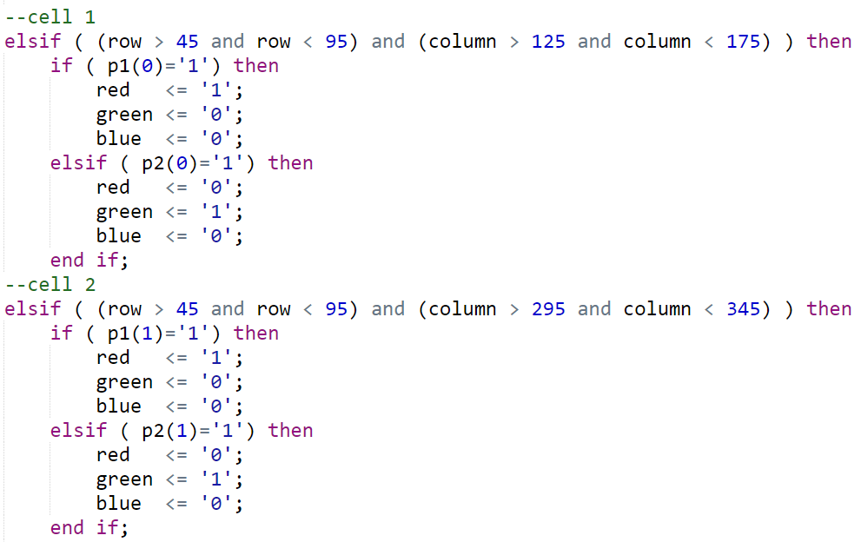
Drawing Game Pieces
VGA control module checks player 1 and player 2 signals to see where game pieces need to be drawn.

Slide 9
Working features of design
Reset of game board
No overwriting of other player’s piece
Mapped keypad (1-9) with positions on 3x3 game board
Displayed users whose turn is it with LED
Display user what key they have pressed on LEDs
Displayed game on VGA with colors to distinguish players
Win detection

Slide 10
Reliability
Full game functionality
Players can’t can't overwrite other game pieces or place new pieces after a game has been won
Only performance problem is some monitors show thin lines in the background.
Issue with pixel clock in some monitors

Slide 11

Video - Demo

Slide 12
Possible features to be added in future
One player Tic-Tac-Toe
Have user play against AI
Score tracking
Display count of wins per user on 7 segment displays

Slide 13
Conclusion
Challenges faced
VGA
Putting it all together
What we learned
Implementation of multiple interfaces
Successful completion of project

Slide 14
References
PS2 Keyboard from class
VGA control and VGA drive modules modified from Rob Chapman, University of Alberta.
Chapman, Rob . “VHDL VGA Driver.” University of Alberta, Department of Electrical and Computer Engineering, www.ece.ualberta.ca/~elliott/ee552/studentAppNotes/1998_w/Altera_UP1_Board_Map/vga.html.

